Slide 1
Project Presentation of Back End Engineering Project (BEE) (22CS026)
On
Employee Management
Kashish 2210991765
Khushi 2210991796
Khushpreet Kaur 221099801
Supervised By
Mr. Rahul Sir
Department of Computer Science and Engineering,
Chitkara University, Punjab

Slide 2
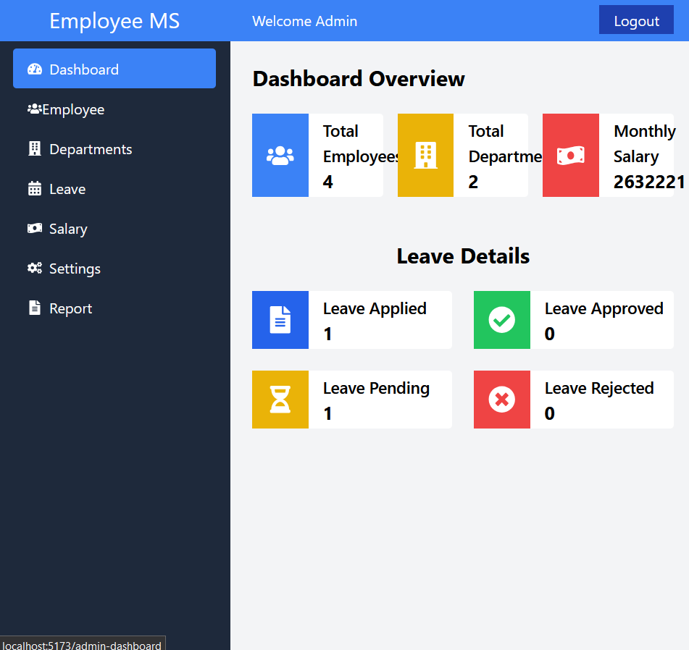
Introduction
The Employee Management (EM) is a web-based application designed to help businesses and organizations efficiently manage employee data and operations. With the growing demand for digital solutions in managing HR processes, this system provides a centralized platform to handle employee information, attendance, tasks, leaves, and performance data.
These technologies work together to deliver a fast, scalable, and responsive system that can be used by administrators, managers, and employees alike.
2

Slide 3
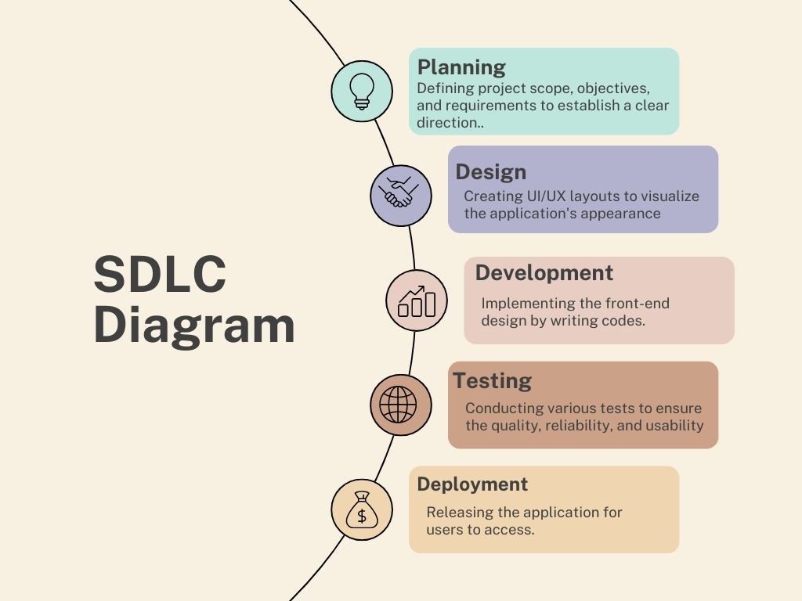
SDLC MODEL

Slide 4

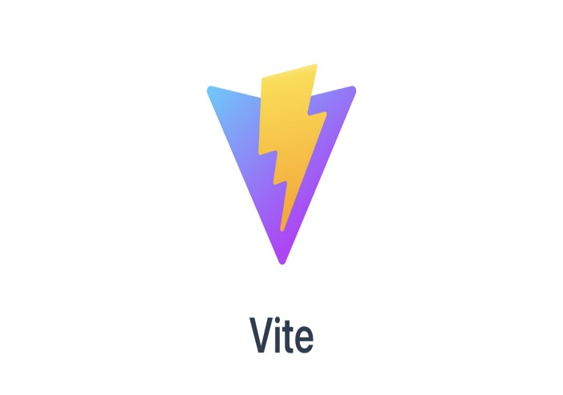
TECHNICAL DETAILS
REACT:
React is a JavaScript library for building dynamic user interfaces.
It enables developers to create reusable components for efficient development.
React uses a virtual DOM to optimize rendering and performance.
Components manage their own state, making applications more interactive and responsive.
It is maintained by Facebook and widely adopted by developers worldwide.
React's flexibility makes it suitable for both web and mobile apps.
VITE:
Vite is a fast, modern build tool for web development.
It leverages native ES modules to speed up the development process.
Vite supports hot module replacement for fast feedback during development.
It provides pre-configured support for frameworks like React and Vue.
Vite offers optimized production builds with minimal configuration requirements.

Slide 5

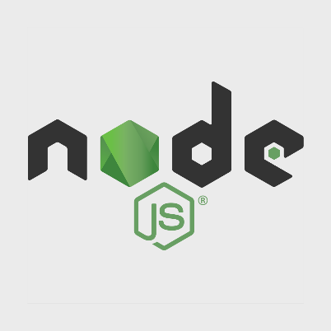


TECHNICAL DETAILS
Backend
MongoDB:
NoSQL database designed for handling large volumes of data.
Uses flexible, JSON-like documents to store data.
Supports dynamic schemas, allowing easy updates to data structure.
Express:
Express is a minimal and flexible Node.js web application framework
that provides a robust set of features for web and mobile applications.
Express is a lightweight and flexible routing framework with minimal
core features meant to be augmented through the use of Express middleware modules.
Multer:
Multer is a middleware for handling file uploads in Node.js, specifically designed to handle multipart/form-data.
It simplifies the process of uploading files to the server by parsing the incoming request and storing files on the server or in memory.
Bcrypt:
Bcrypt is a hashing algorithm used for securely storing passwords.
It adds a salt to the hash, making it resistant to rainbow table attacks.

Slide 6
Features
Overview: The MERN Stack Employee Management System is a web-based application that helps businesses efficiently manage employee data, attendance, tasks, and performance using MongoDB, Express.js, React.js, and Node.js.
Key Features:
Admin Authentication & Authorization
Employee Profile Management
Leave Management
Salary Management
Role-Based Access Control

Slide 7
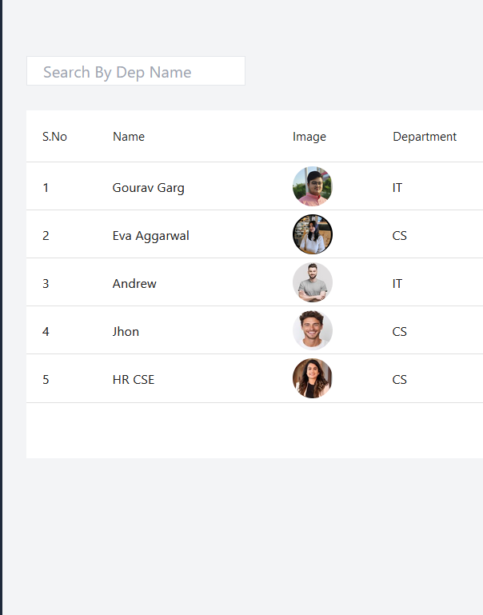
Target Audience
Who is this for?
Managers
Employees
Admins
Small and Large Organizations
Goal: The goal of the Employee Management Project is to automate HR processes like employee data management, attendance, tasks, and leaves. This enhances efficiency, accuracy, and productivity.

Slide 8
User-Friendly Interface
Intuitive Navigation: Clear, organized menus and icons that help users find what they need without confusion.
Simple Layout: A clean, uncluttered design that focuses on the most important features, avoiding unnecessary complexity.
Responsive Design: An interface that adapts well to different devices (desktop, mobile, tablet) and screen sizes.

Slide 9
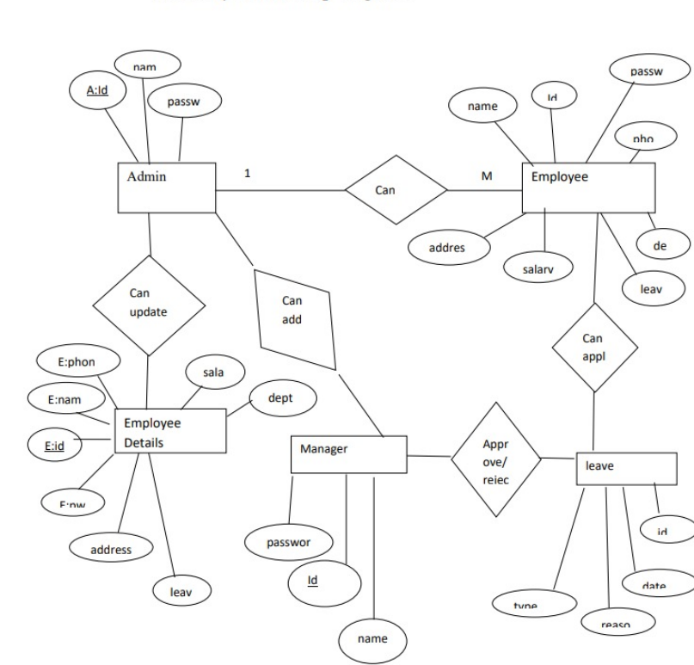
ER Diagram

Slide 10
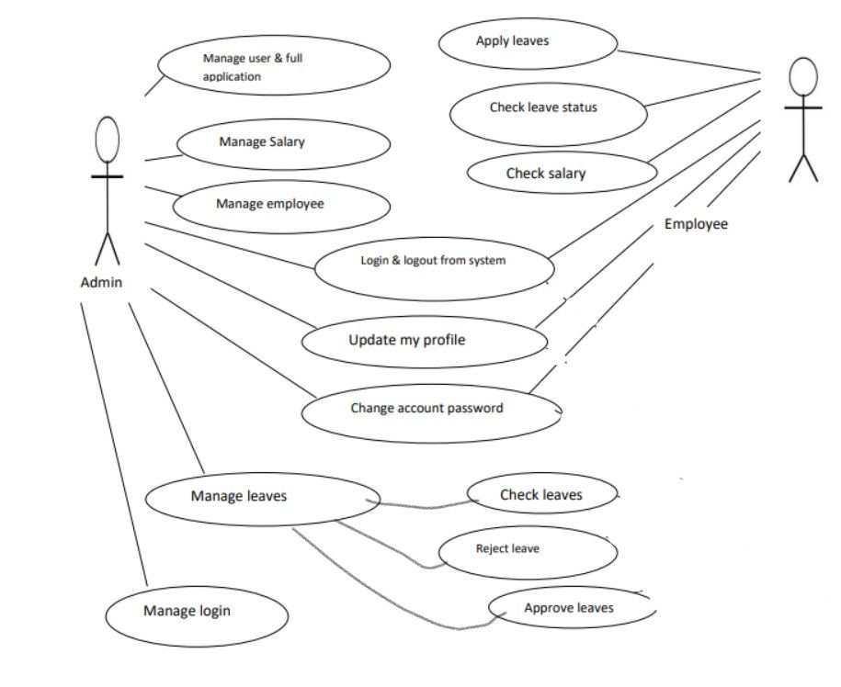
Use Case Diagram

Slide 11
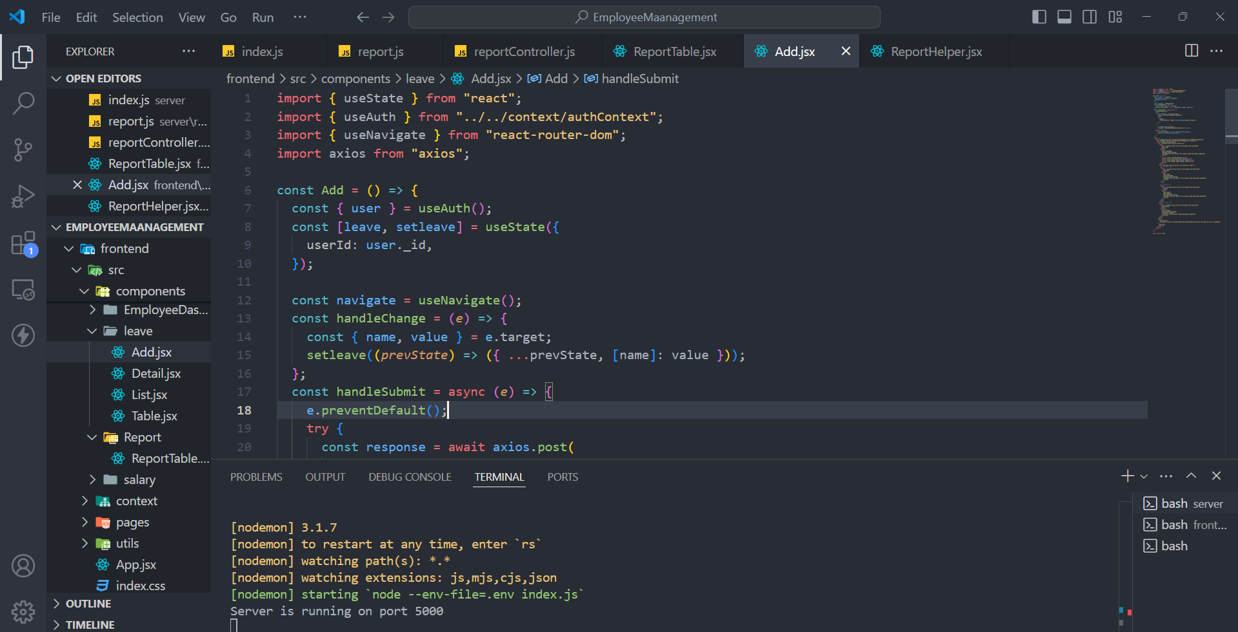
Code Snippets

Slide 12
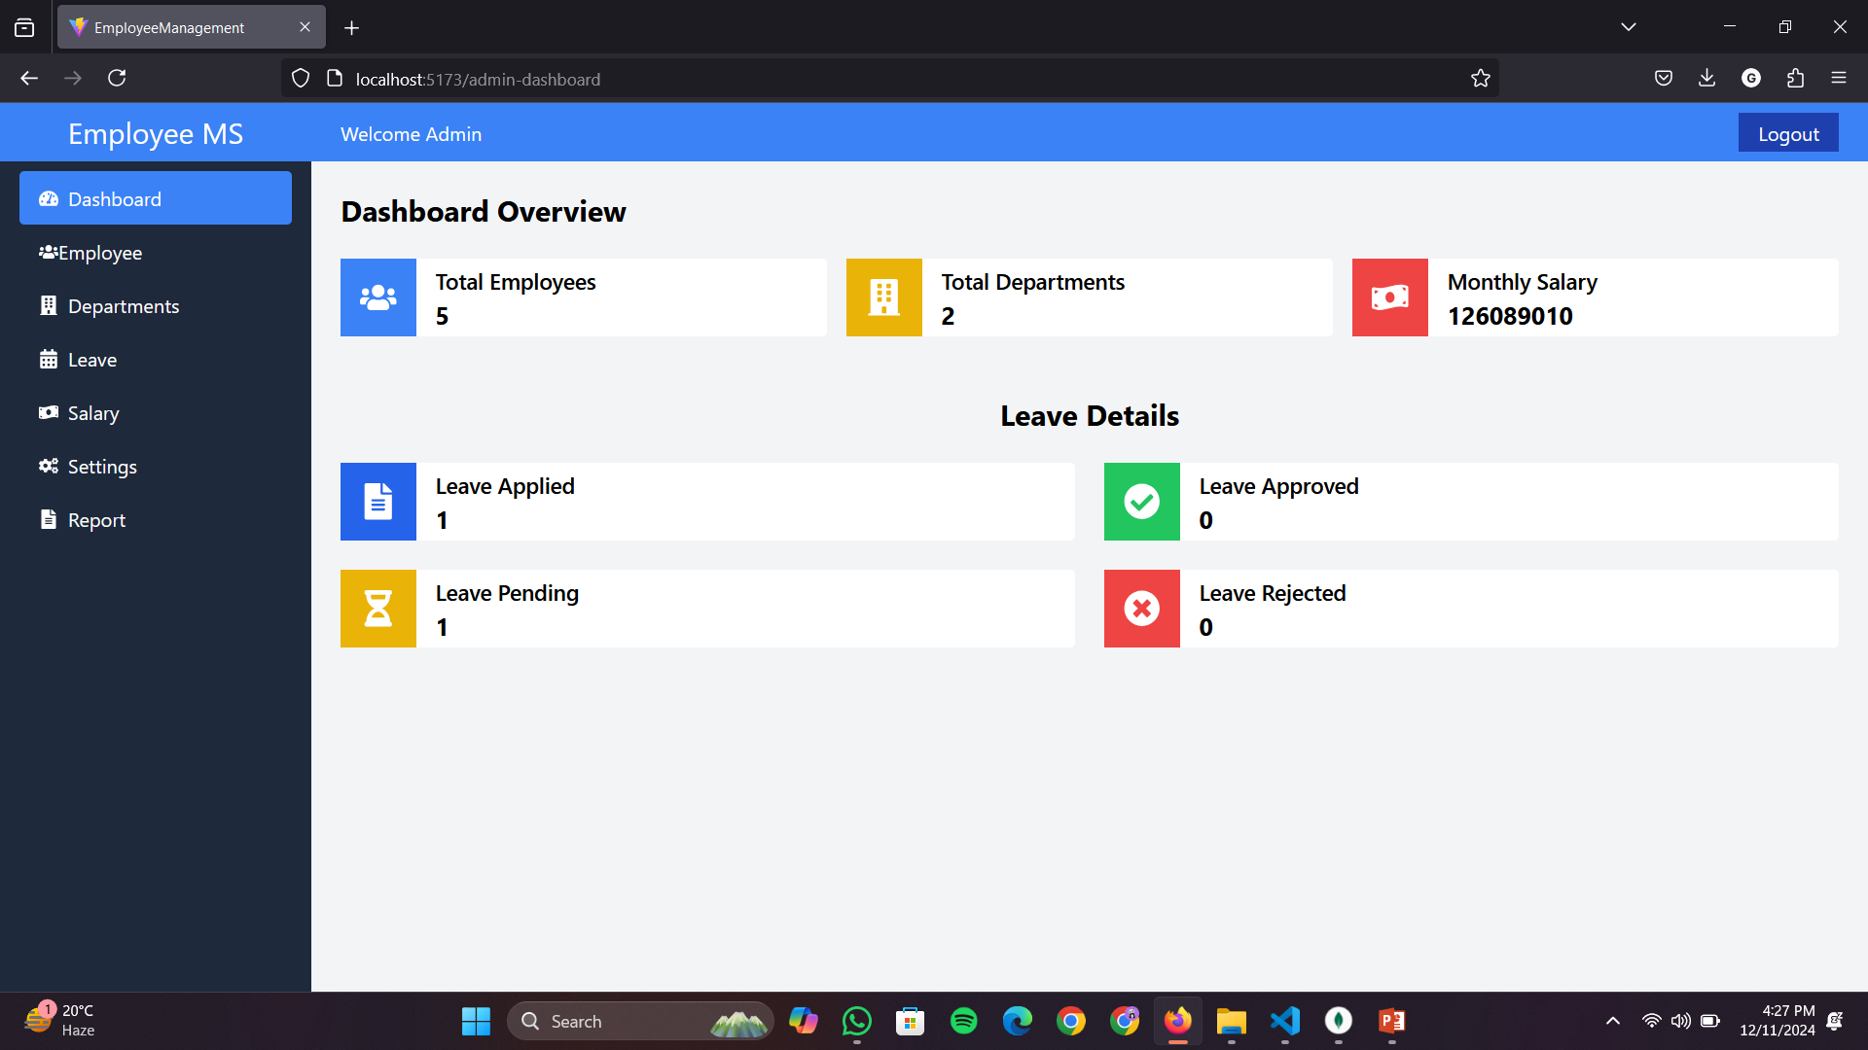
Output

Slide 13
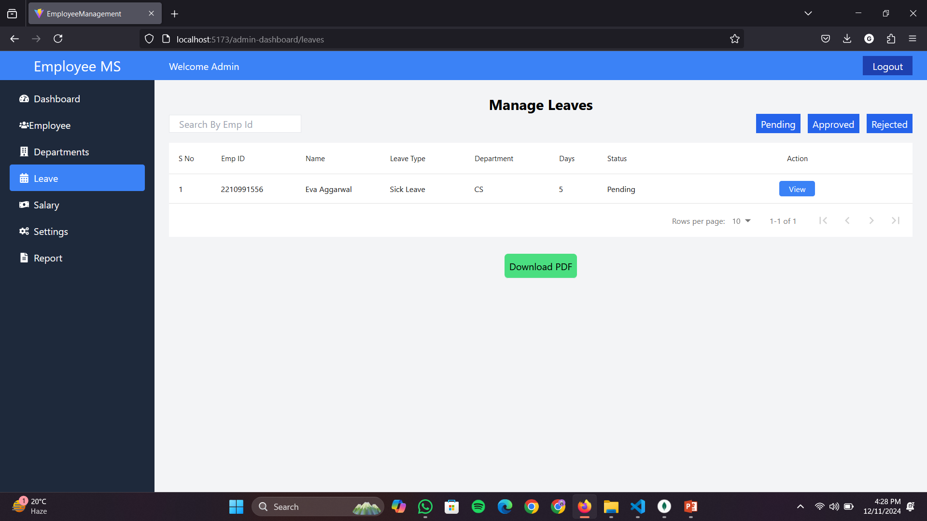
Output

Slide 14
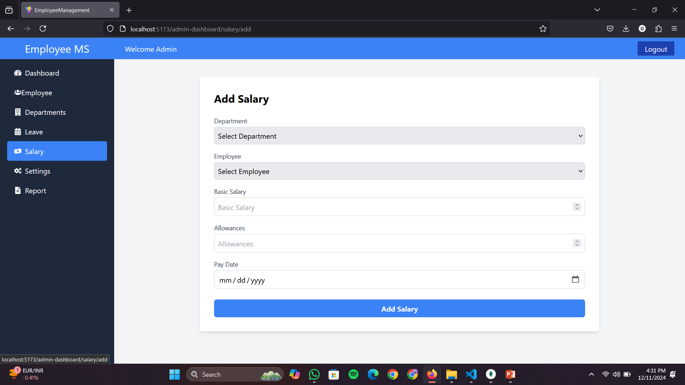
Output

Slide 15

CONCLUSION
A MERN stack-based Employee Management System provides a scalable, efficient, and responsive solution for managing employee data. With MongoDB for flexible data storage, Express.js and Node.js for a fast backend, and React.js for dynamic front-end development, it ensures smooth operations and a great user experience. The system is secure, easy to maintain, and capable of handling large datasets, making it ideal for modern HR management.
Efficient Backend: Express.js and Node.js provide fast and lightweight backend functionality.
Dynamic Frontend: React.js enables a responsive and interactive user interface.
Security: Supports secure authentication and data protection protocols..
Real-time Interaction: Smooth integration between frontend and backend for real-time updates.

Slide 16


